Slide 1
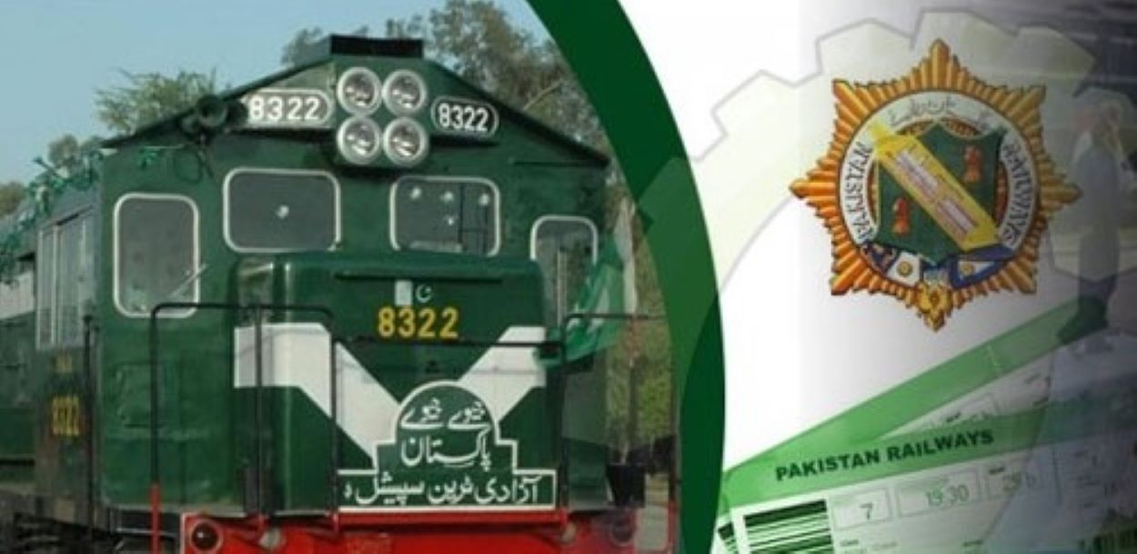

Railway management system
Group. f
Umar Ahmad bsse23032
Ali Hasnain bsse23066
Muhammad Abdullah bsse23100

Slide 2
Task Division
Admin-> Route-> Date and time->Schedule->Station->Platform->Announcement
Umar Ahmad
Ali Hasnain
M Abdullah
Train->seat-> Boogie->Engine->Passenger->Dining Car->Dining Table->Feedback
Management->Staff->Ticket->Business class->Lower Ac->Local->Payment

Slide 3
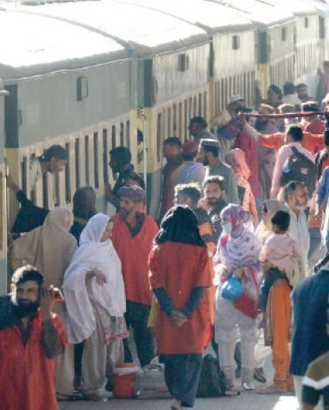
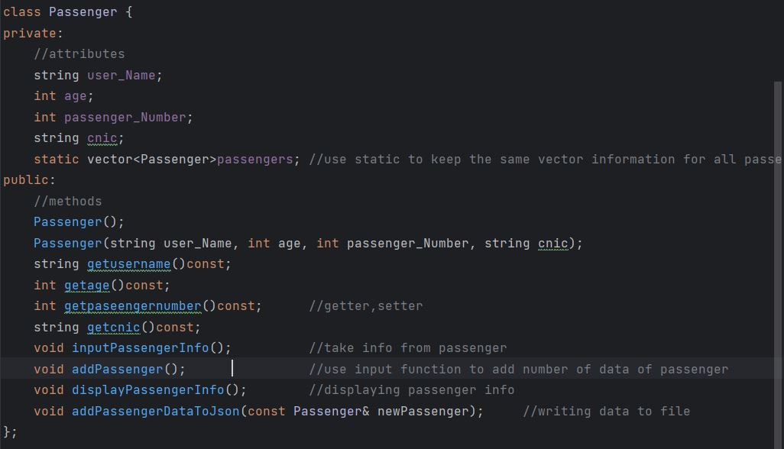
Passenger
Manages data of passengers.
Take basic info of passengers coming on portal.

Slide 4
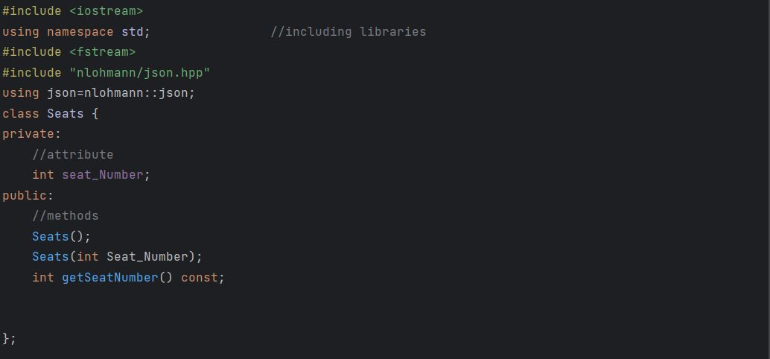
Seat
Manages seats in the Boogie
Composed in the Boogie

Slide 5
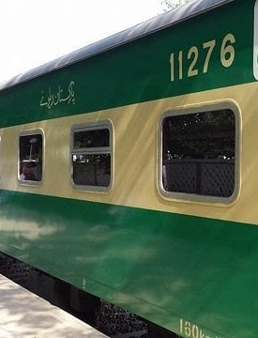
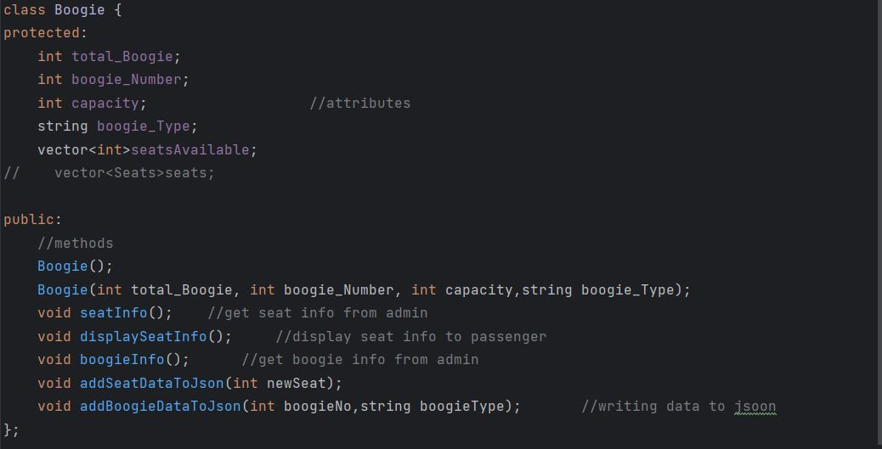
boogie
Manages seats and boogie info
Manage boogie numbers and types

Slide 6
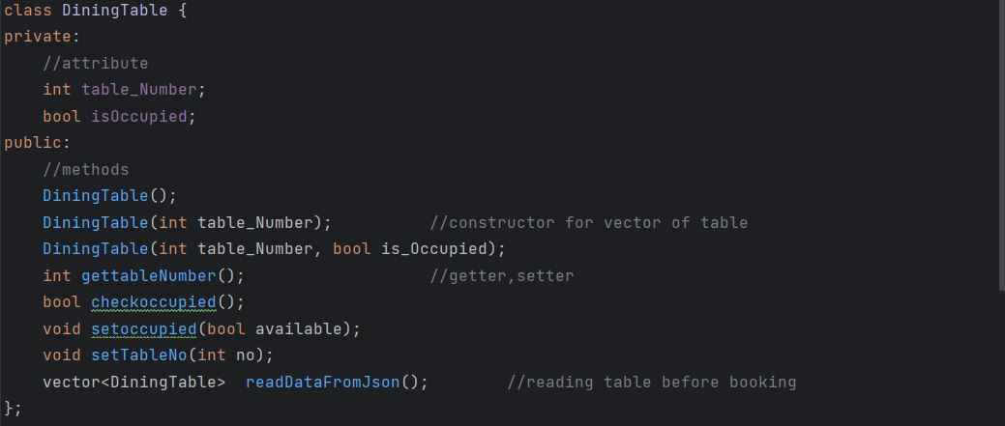
Dining table
Manages tables in the dining boogie
Composed int the Dining Car

Slide 7
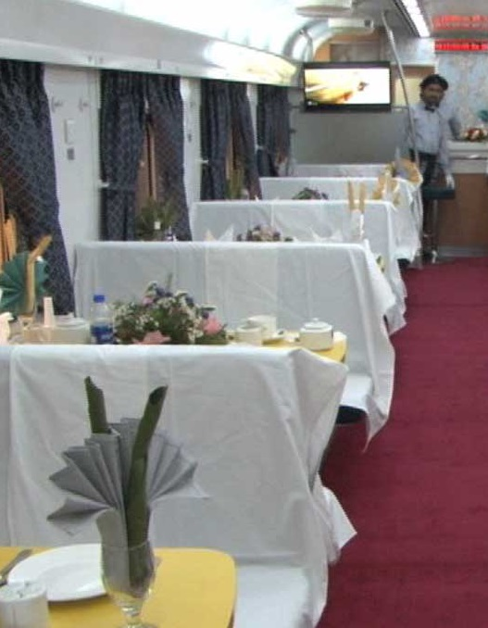
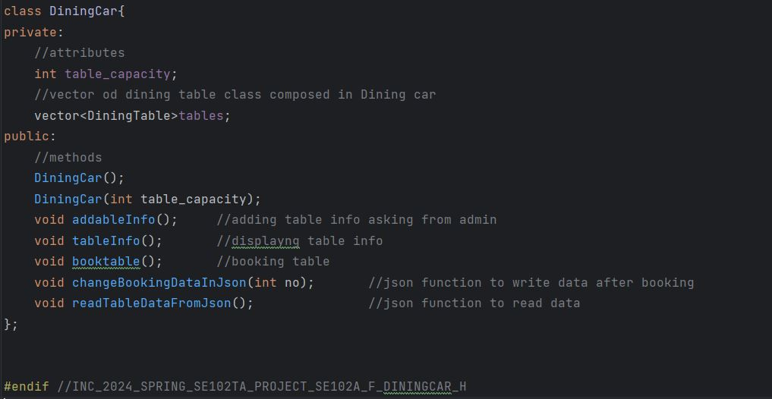
Dining Car
Manages Dining tables in train
Allow passenger to book and display tables

Slide 8
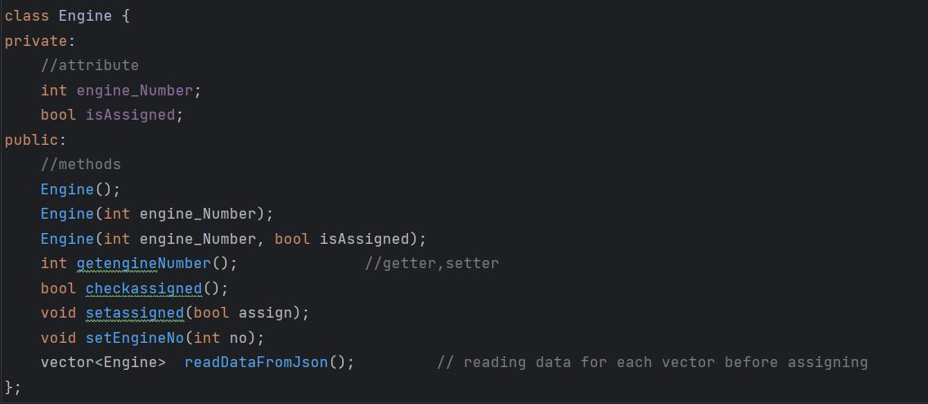
Engine
Manages Engine Info in train
Allow admin to assign and display engines

Slide 9
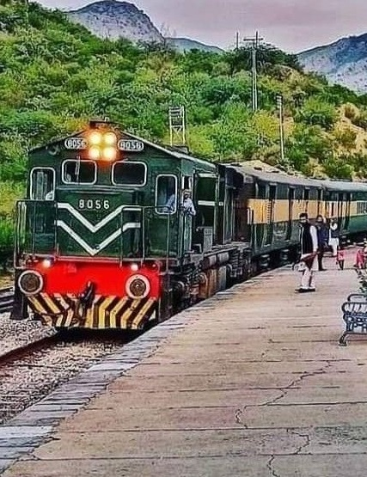
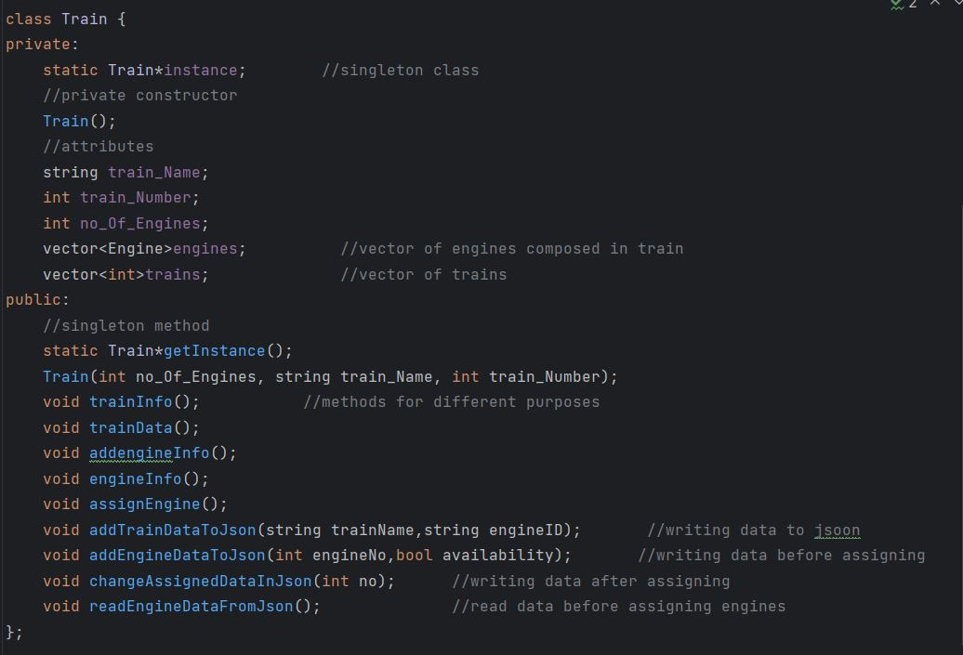
Train
Manages train Info of Routes
Display train number on the Routes

Slide 10

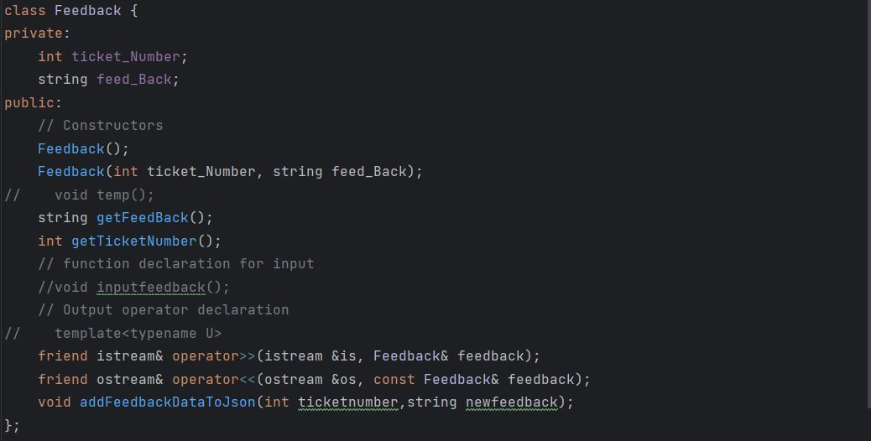
feedback
Allow Passenger to give feedback

Slide 11
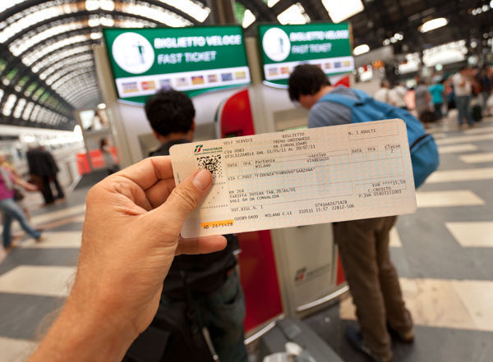
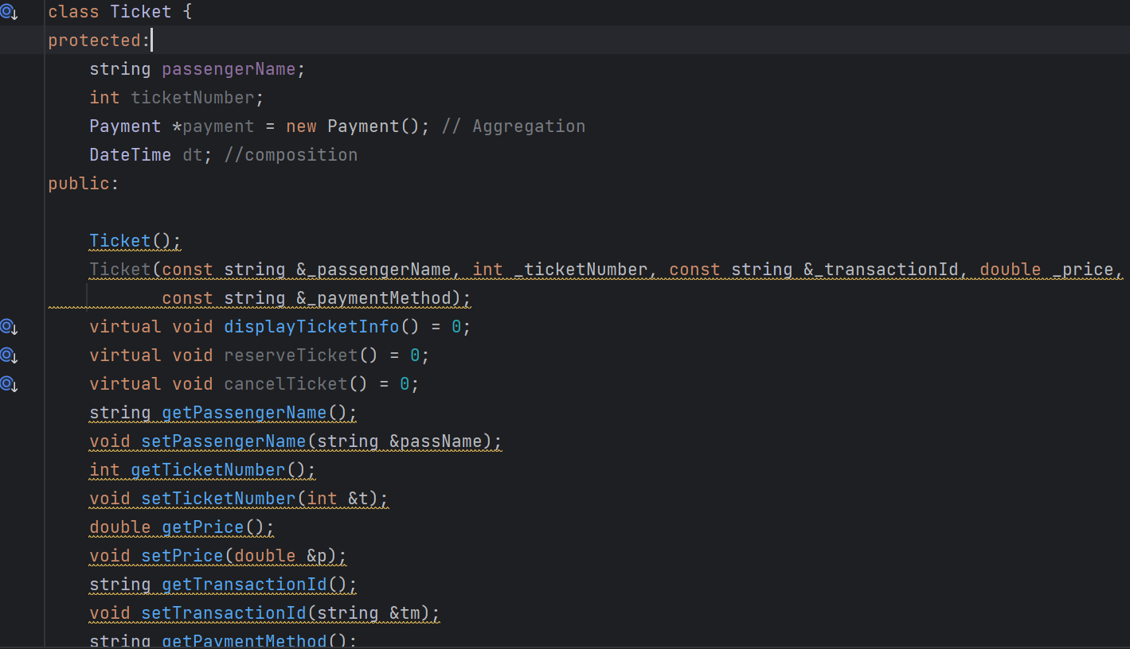
Ticket Abstract Class having Polymorphism generates ticket

Slide 12
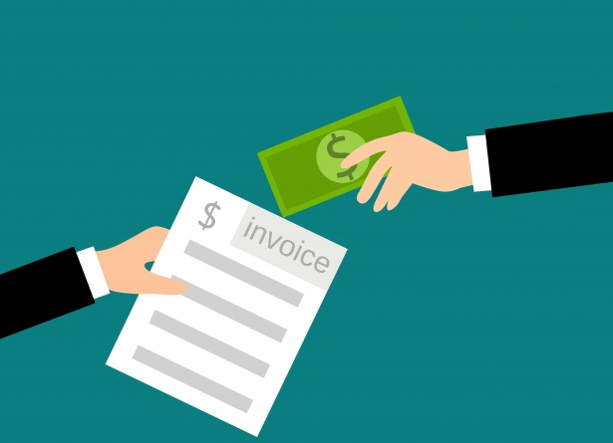
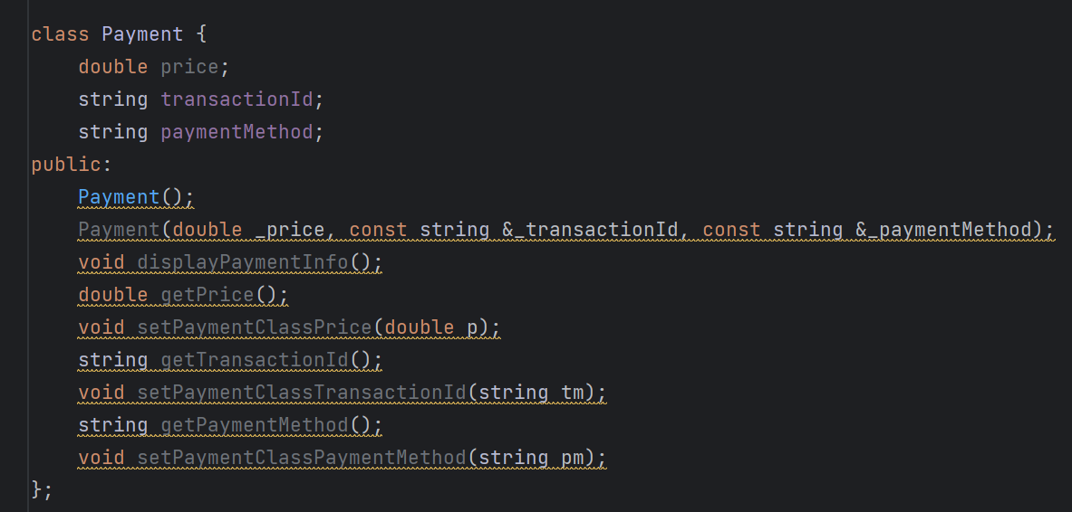
Payment Aggregated In Ticket payment across corresponding ticket

Slide 13
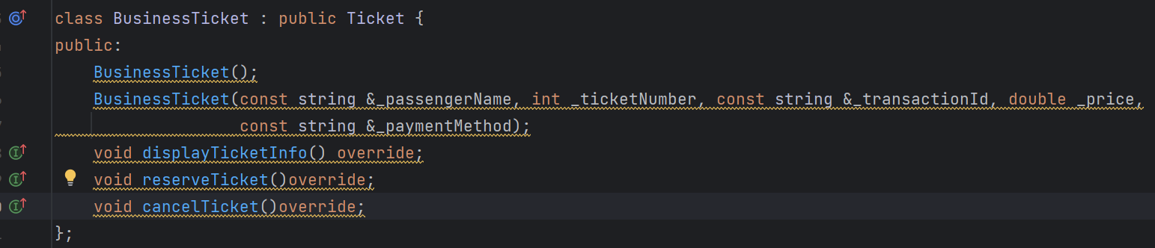
Business Ticket Inherits From Ticket books business class ticket

Slide 14
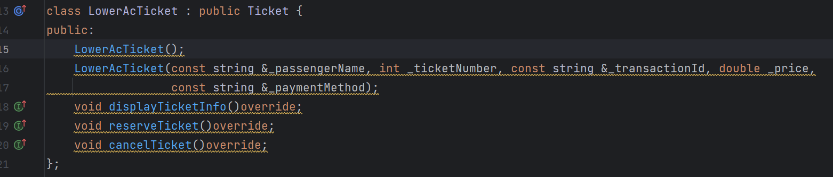
Lower AC Ticket Inherits From Ticket books Lower ac class ticket

Slide 15
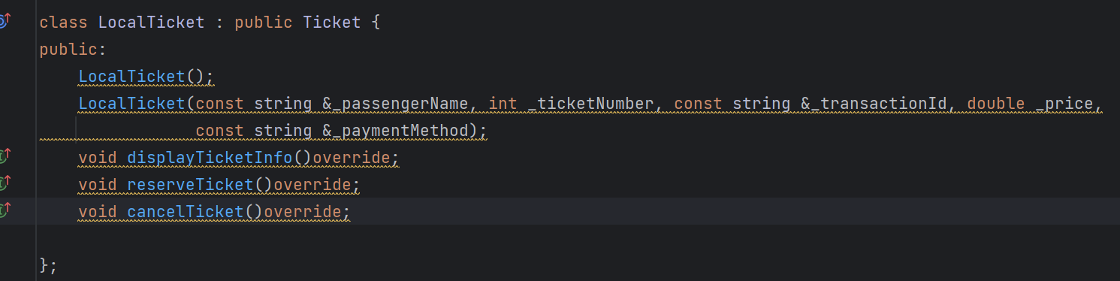
Local Ticket Inherits From Ticket books economy class ticket

Slide 16
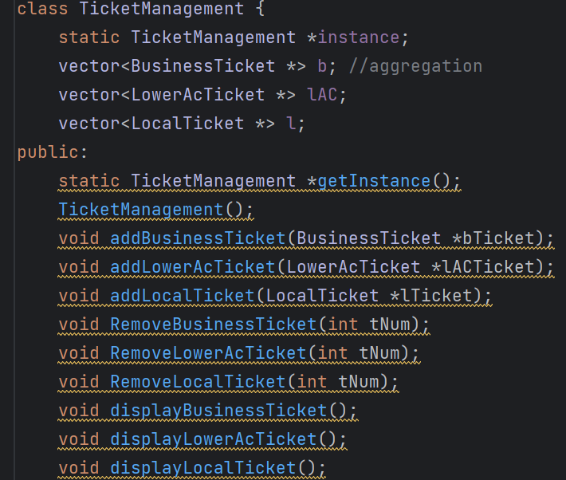
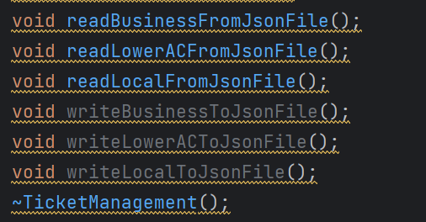
Ticket Management manages all tickets Adding And Removing Tickets handles filing

Slide 17
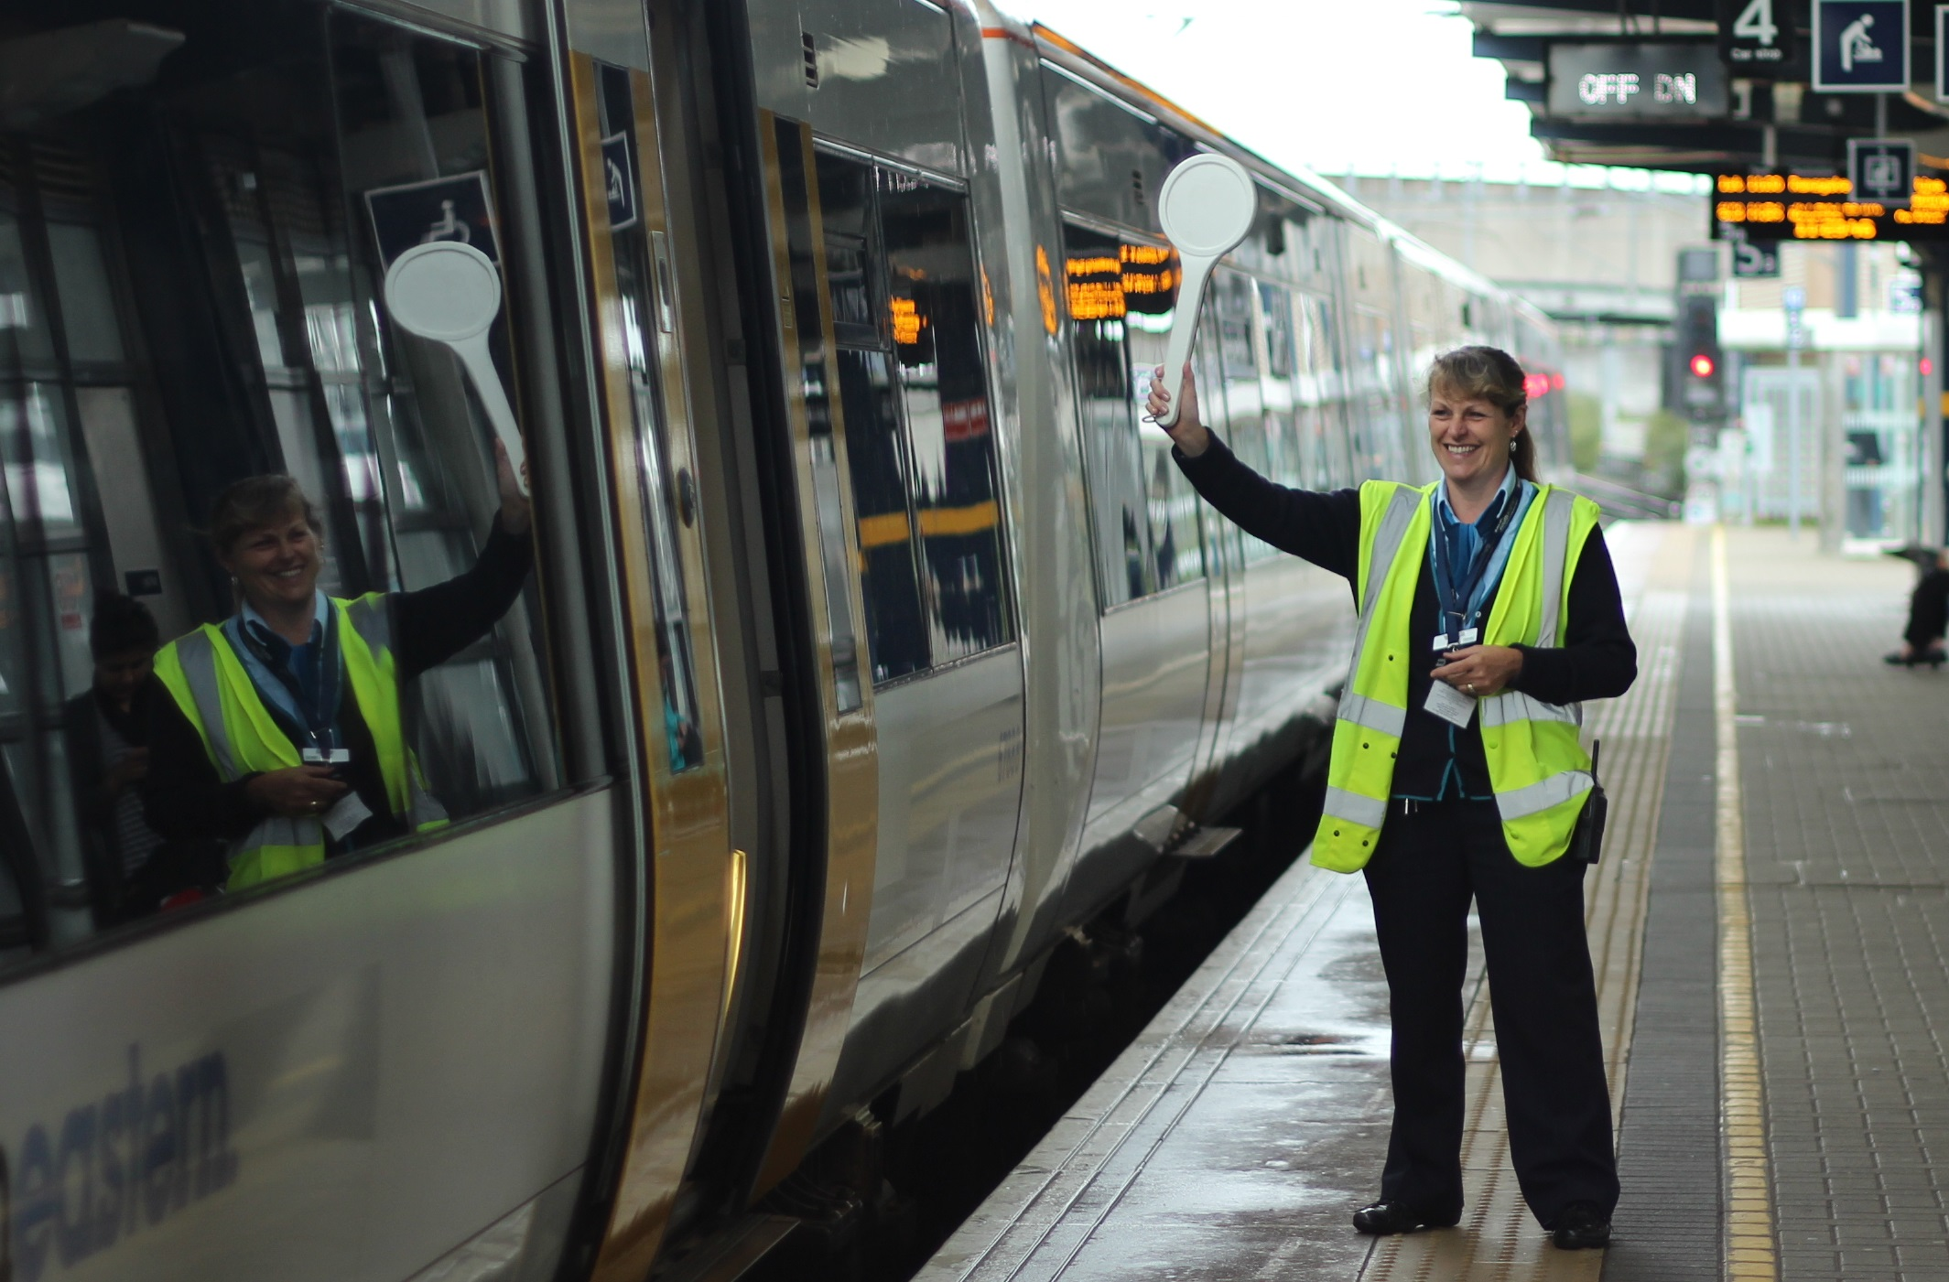
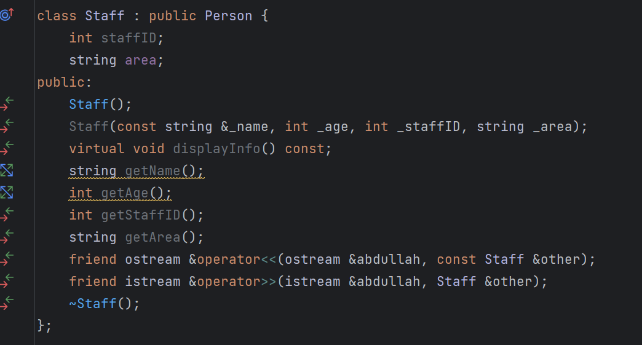
Staff goes with train stays at station

